Slide 1



Server-side spatial analysis of radiological data using PostGIS
PostMaster

Slide 2
Outline
Team qualification
Problem statement
Selected Approach
Project plan
Notes:
· Selected Approach that contains Backend Development, System architecture, Data pre-processing and License

Slide 3
Team qualification

Slide 4


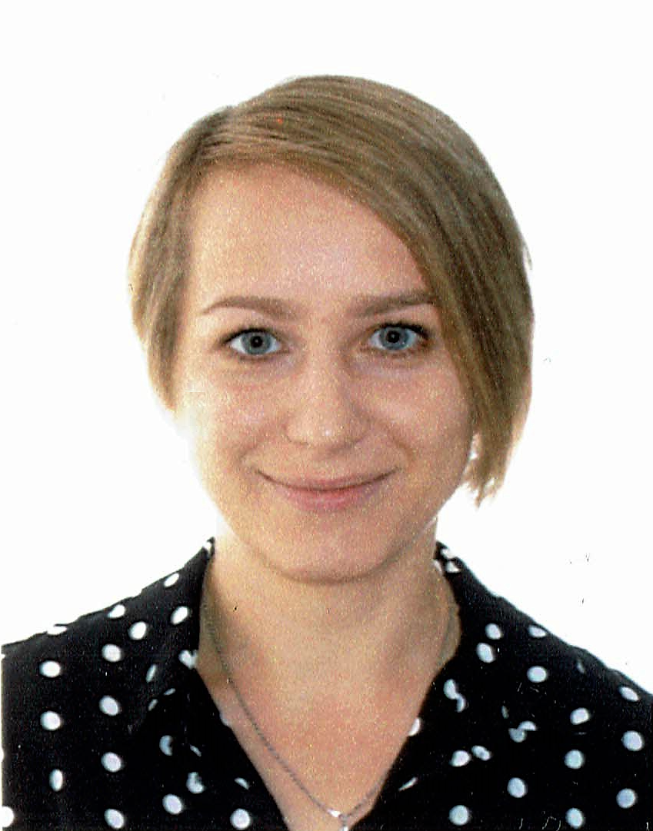
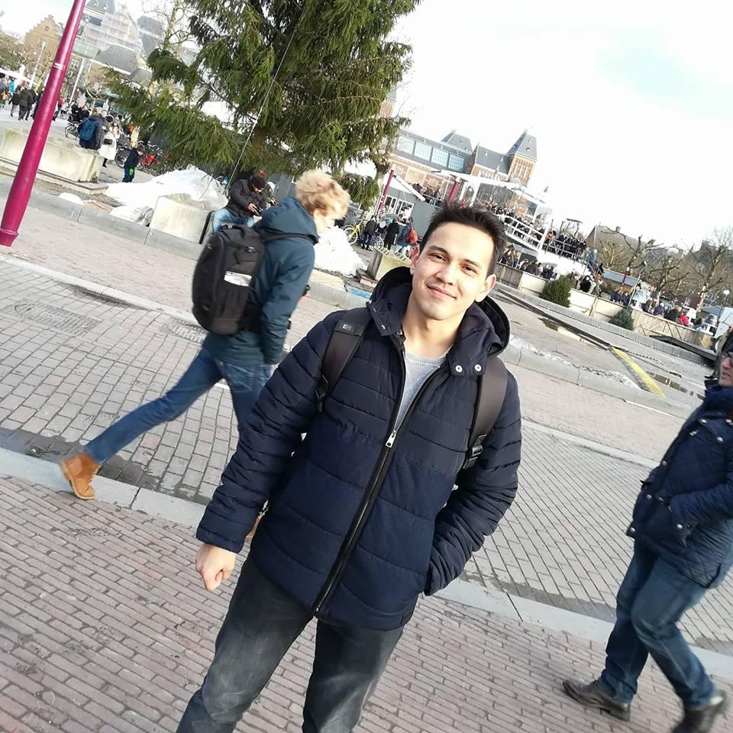

Ghalichehbaf Saeid
Hassan Omer
Ivanova Anastasia
Team member
Team member
Team member
PostMaster
Samedov Agageldi
Wicht Marzena
Team member
Team member
Notes:
Our company is called PostMaster and is made up of 5 people. I started by presenting each one of us.

Slide 5
Saeid Ghalichehbaf
From Iran / Tabriz
Master student in Geomatics Hochschule Karlsruhe Technik und Wirtschaft
Bachelor Degree in Geomatics Engineering in Iran/Tabriz
Skills useful for the project:
Excellent command of MS Office
Extensive knowledge in AutoCAD, ArcGIS, Matlab
Knowledge in Australis, Photomod, HTML
Basic knowledge in Java, JavaScript, PostgreSQL/PostGIS, Geo-Web-Services

Slide 6
Agageldi Samedov
MSc student (Geomatics master),(HsKA), third semester.
BSc in Applied Geodesy, Turkmen state institute of architecture and construction
Professional experience in Surveying and Road designing
Skills useful for the project:
good knowledge on programming languages (js, java, C, python, SQL) and passion for challenge
From Turkmenistan / Ashgabat

Slide 7
Marzena Wicht
MSc student (Geomatics master),(HsKA), third semester.
MSc in Urban Planning , PhD candidate at WUT (Poland)
Professional experience in urban planning, spatial and environmental analyses, teaching
Skills useful for the project:
project and documentation management, extensive knowledge in QGIS, good command of SQL, JS, PostgreSQL/PostGIS
From Poland / Suwałki
Notes:
WUT = Warsaw University of Technology

Slide 8
Hassan Omer
MSc student (Geomatics master), University of Applied Sciences Karlsruhe (HsKA), third semester.
Bachelor of Science (B.Sc.) Surveying Engineering, Faculty of Engineering at University of Khartoum, Sudan.
5 years’ experience as Surveying Engineer ( Sudan and Saudi Arabia ).
Skills useful for the project:
From Khartoum /Sudan
ArcGIS, Web GIS.
Very good knowledge in Java, JavaScript, HTML.
Python Basics, ArcPy.
Basics knowledge in Android Studio.
PostgreSQL/PostGIS, Geo-Web-Services.

Slide 9
Anastasia Ivanova
MSc student (International Master's Programme in Geomatics at the Hochschule Karlsruhe Technik und Wirtschaft and Polytechnic University of Valencia)
BSc in Geomatics and Topography Engineering (Polytechnic University of Valencia)
Skills useful for the project:
Extensive knowledges in ArcGIS, QGIS.
Good knowledge in Matlab, Python, JavaScript, HTML, CSS, PostgreSQL
From Russia/Tula

Slide 10
Problem statement
Server-side spatial analysis of radiological data using PostGIS
Radiological data from Federal Office for Radiation Protection:
Voronoi
TIN
Notes:
As we know the spatial analysis is a fundamental function for geographic information systems but its capability is very limited in a Web-GIS environment, especially when relational database is used for geospatial data management. This project proposes a Server-side spatial analysis of radiological data using PostGIS. This project also includes optimizations, that means we have to create datasets with different scales and comparing different solutions.
Voronoi and TIN are the most advanced analysis. To keep the attributes is very important in these analyses.
Now we are going to describe those two types of spatial analysis.

Slide 11
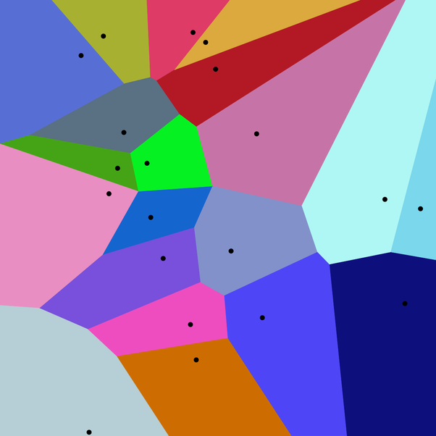
Voronoi
Points in convex polygons
Each polygon contains exactly one point
Every point in a polygon is closer to its generating point than to any other
Also known as a Dirichlet tessellation or cells are called Dirichlet regions,Thiessen polytopes, or Voronoi polygons.

Slide 12
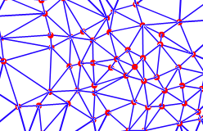
TIN
Triangulated Irregular Network
Vector-based representation of a surface.
TINs are commonly used in terrain representation
But usable for representing other variables which can be as surfaces.
TINs consist a series of contiguous, non-overlapping triangles that are known as faces.
Created from a series of points using a technique called Delaunay triangulation
TINs are also used to construct Thiessen polygons, which form the basis for interpolating to areas.

Slide 13
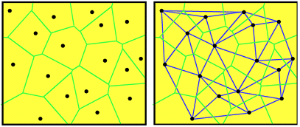
Voronoi and TIN
Notes:
TIN derived out of Voronoi polygons

Slide 14
Selected Approach

Slide 15

Server-side Development
what you can’t see...
Notes:
back-end development is any kind of development that doesn’t involve creating code that produces a user interface.
In that manner - Maybe we can say, Titanic sank because it crashed on the backend.

Slide 16
Backend Development
Server-side Development
The backend of a web application is an enabler for a frontend experience.
The backend of an application is responsible for things like calculations, business logic, database interactions, and performance.
Most of the code that is required to make an application work will be done on the backend. Backend code is run on the server, as opposed to the client.
If an application is slow, crashes often, or constantly throws errors at users, it’s likely because of backend problems.

Slide 17
Backend Development
Server-side Development
Technologies / Languages
Server side languages Node, PHP
Frameworks like Express, Laravel
Database & Query Languages
Partly server configurations
Less or not relevant
Technologies / Languages
HTML
CSS
JS
Build Tools
Libraries (JQuery, Sass, Leaflet, D3)

Slide 18
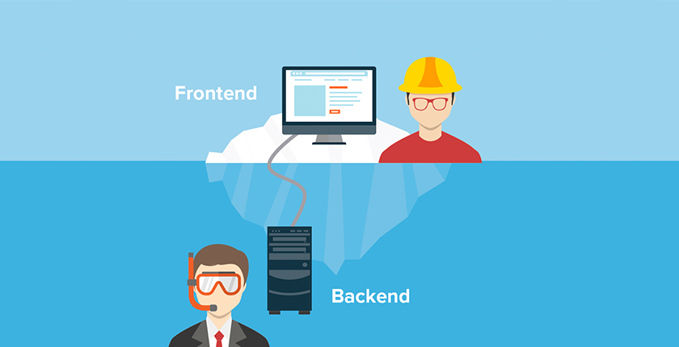
System architecture
Notes:
Now you have idea about our project and tasks, we would like to present you architecture of our project

Slide 19
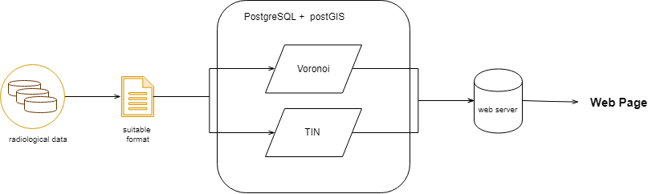
System architecture
Notes:
This is first prototype of our system architecture, during the development we will improve it by adding our new ideas

Slide 20
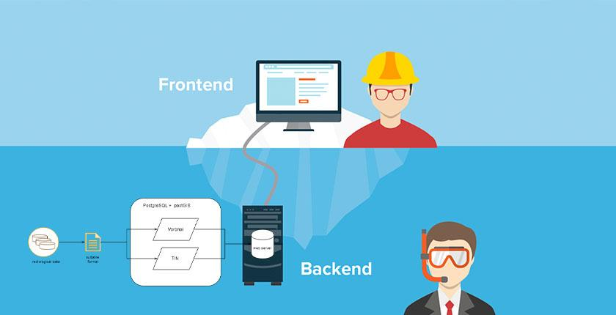
System architecture

Slide 21

PostgreSQL / PostGIS
PostgreSQL: The World's Most Advanced Open Source Relational Database
Powerful, open source object-relational database system
Latest release (11) : October 2018

Slide 22

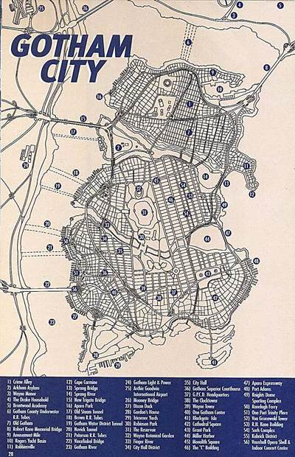
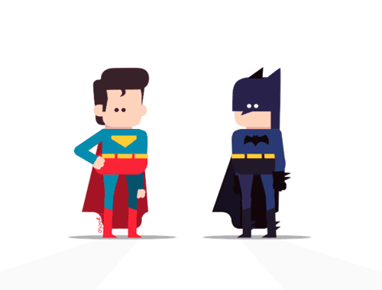
PostgreSQL / PostGIS
PostGIS: a spatial database extender for PostgreSQL
adds support for geographic objects allowing location queries to be run in SQL
SELECT superhero.name
FROM city, superhero
WHERE ST_Contains(city.geom, superhero.geom)
AND city.name = 'Gotham';

Slide 23
Tasks
Set up DB (VM / OSGeoLive)
Create schema/import table
Import data into DB table
Create processing schema
Perform spatial analysis (Voronoi, TIN , spatial joins, clip etc.)

Slide 24
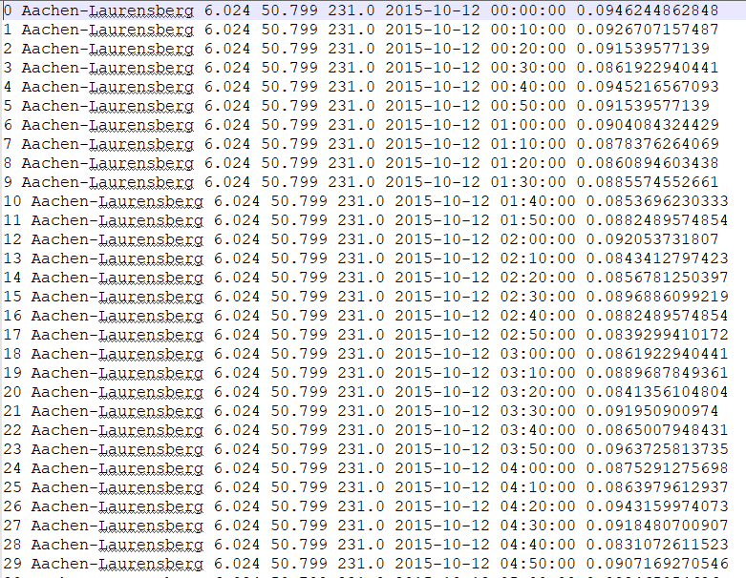
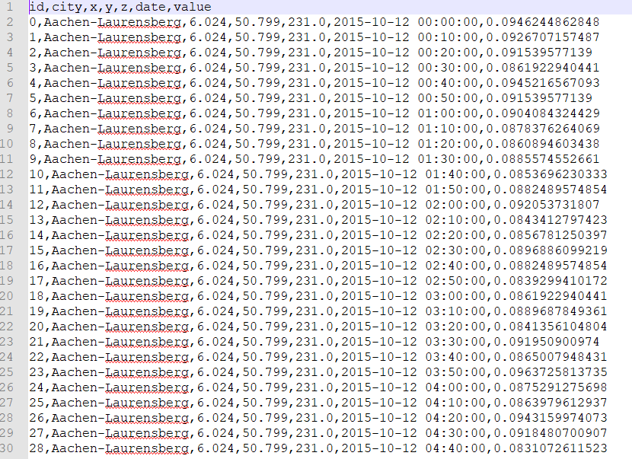
Data preprocessing

Slide 25
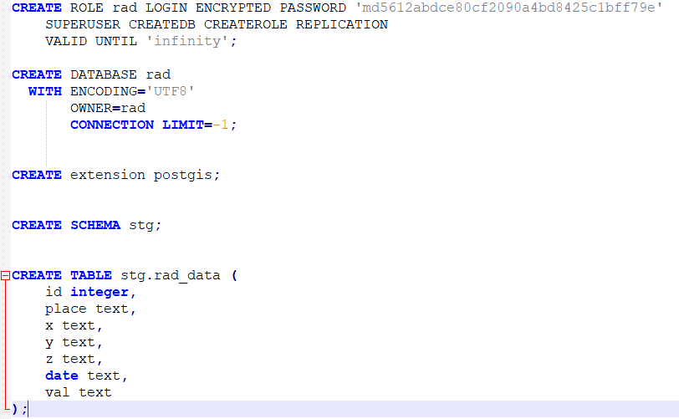
DB & table creation

Slide 26
Data import
pgAdmin GUI
Or command line → define host, db and user invoking psql in front (psql -h localhost -d rad -U user)
\copy stg.rad_data from '/media/sf_e/vm_exchange/data.csv' delimiter ',' csv header
into
Path of the file
First line treated as a header

Slide 27
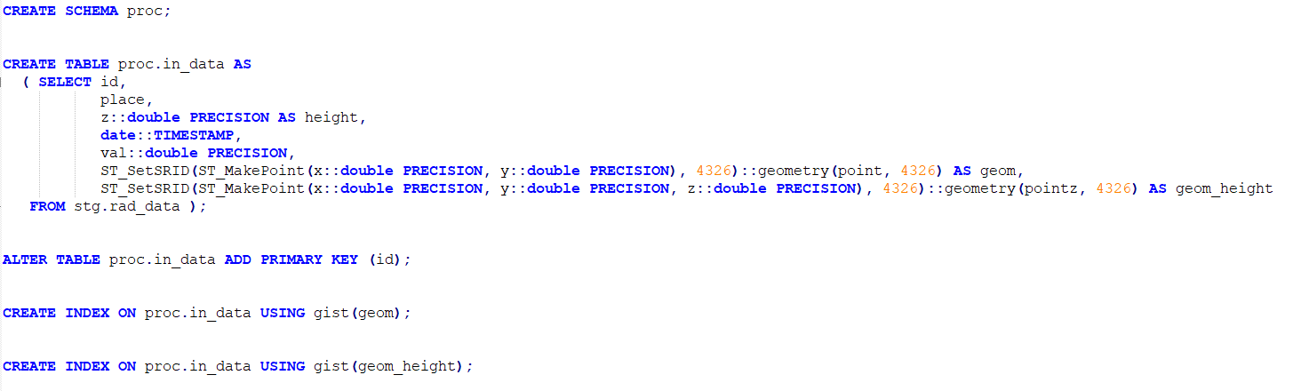
Data handling

Slide 28
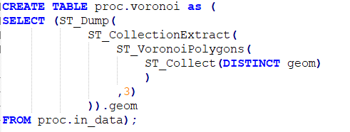
First voronoi attempt
Notes:
First we collect distinct points geometries (there are numerous points overlapping each other) with st_collect. They are used as an input to vornoi function
The result of st_voronoiPolygons is a GeometryCollection (it can be everything mixed). That is why, we use st_collectionextract (Given a (multi)geometry, return a (multi)geometry consisting only of elements of the specified type.) type 3 refers to polygons (1 - point, 2 - line)
St_dump dismantles every multigeometry to single geometries (reverse of a GROUP BY)

Slide 29
First voronoi attempt
Possibilities?

Slide 30
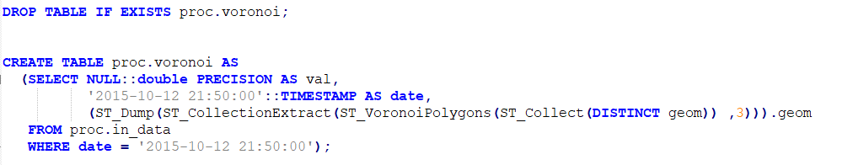
First voronoi attempt
Create vornoi from one, particular date

Slide 31
First voronoi attempt
What about attributes?

Slide 32
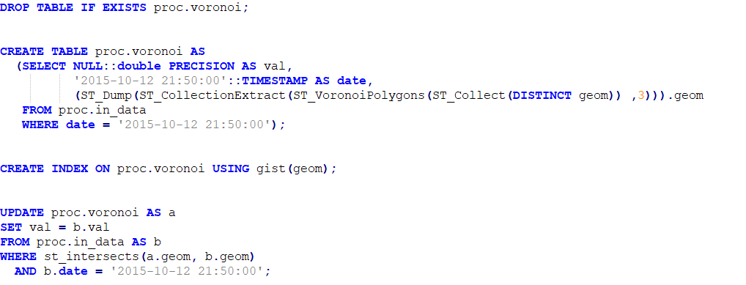
First voronoi attempt
Create vornoi from one, particular date and get the attribute

Slide 33
Next tasks
Create processing schema and import raw data to new table with proper data types and SRID (cast [::])
Create spatial indexes on geometries
Research into ST_VoronoiPolygons and ST_DelaunayTriangles
Handle overlapping points with DISTINCT or choosing date stamp
Perform spatial analysis (Voronoi, TIN , spatial joins, clip etc.)

Slide 34
License
Why we need licenses:
Allows running the program for any purpose without any limitations
Study how the program works and edit it without any limitations
The freedom to redistribute copies
Allows freedom to improve the program and release improved versions

Slide 35
License choice
Popular Licenses
Apache License 2.0
BSD 3-Clause "New" or "Revised" license
BSD 2-Clause "Simplified" or "FreeBSD" license
GNU General Public License (GPL)
GNU Library or "Lesser" General Public License (LGPL)
MIT license
Mozilla Public License 2.0
Common Development and Distribution License
Eclipse Public License

Slide 36

Our license
GNU General Public License version 2 (Version 2, June 1991).
The GNU General Public License, often shortened to GNU GPL (or simply GPL), lists terms and conditions for copying, modifying and distributing free software.
The GPL was created by Richard Stallman in order to protect GNU software from being made proprietary.
It’s the most used licenses which end users (individuals, organizations, companies).

Slide 37
GNU General Public License version 2
It is a specific implementation of his "copyleft" concept.
According to Stallman, copyleft is a derivative of copyright law that serves "the opposite of its usual purpose: instead of a means of privatizing software, it becomes a means of keeping software free." (The name was taken from the humorous slogan, "Copyleft -- all rights reversed.")
Copyleft:
Copyleft is a general method for making a program (or other work) free (in the sense of freedom, not “zero price”), and requiring all modified and extended versions of the program to be free as well.

Slide 38
GNU General Public License version 2
Sponsored by the Free Software Foundation (FSF)
the Free Software Foundation (FSF) is a nonprofit with a worldwide mission to promote computer user freedom.
FSF defend the rights of all software users

Slide 39

Why GNU General Public License version 2?
Freedom to share and change it, then it guarantee that the software is free for all its users.
GNU License is designed to ensure about freedom of the distribution of the copies.
It is copyleft.
GPL uses all the time the same license when someone modify the software.
It is approved by the principal free software communities.
Patent addition can’t turn the program non-free.
PostGIS was released under this license.
By Renai LeMay

Slide 40
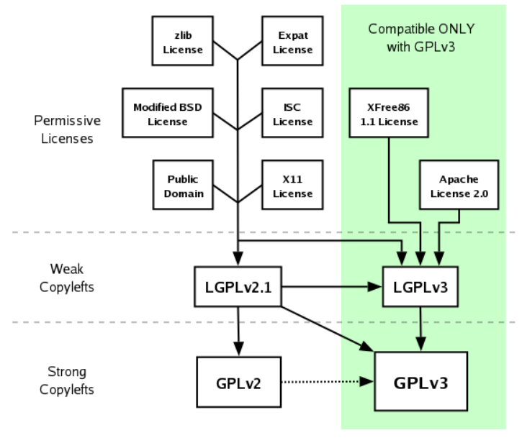
Why version 2?
(GPLv3) is the latest version of the GNU GPL and it is not compatible with GPLv2 by itself.
Most software released under GPLv2 allows you to use the terms of later versions of the GPL as well.

Slide 41
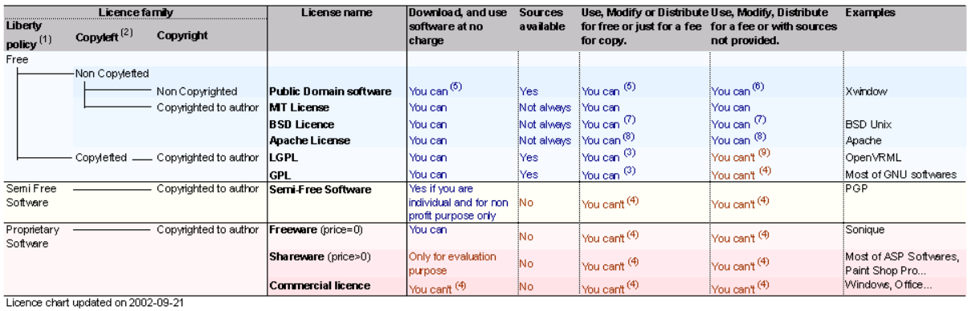
Licence chart

Slide 42
Project plan

Slide 43
Timeline
OCT 2018
NOV 2018
DEC 2018
JAN 2019
Requirements gathering
User research / Programing /
First release
Programming/
Second release
Programming/
Finalrelease

Slide 44
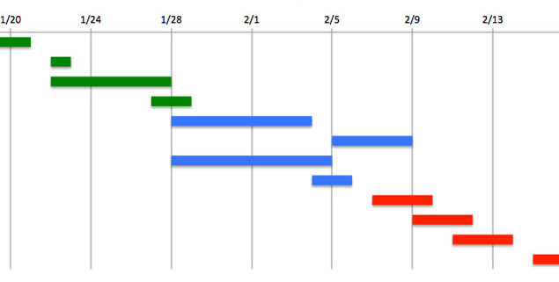
Gantt chart

Slide 45


